Slide 1
Additional Teves
December 3, 2023

Slide 2
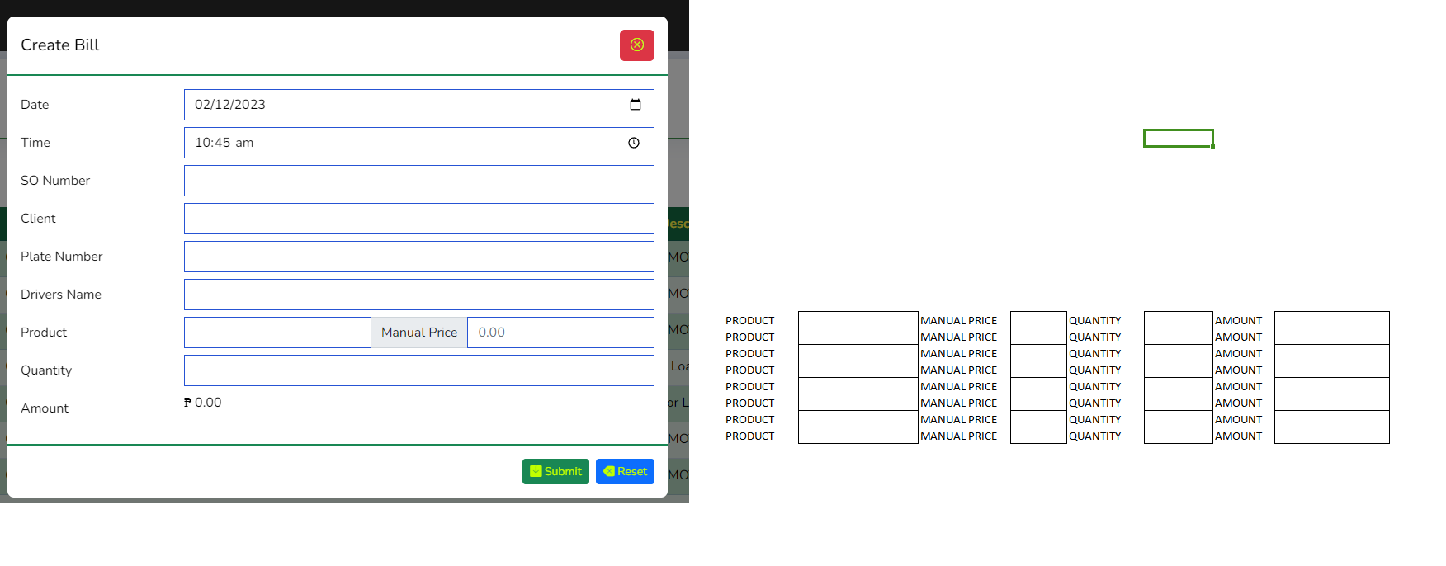
Limit to 6 Entry for SO Number
Updated December 3, 2023

Slide 3
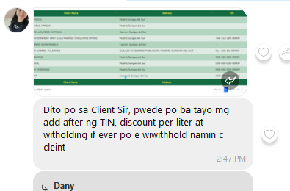
Default Value to Include on Client Details

Slide 4
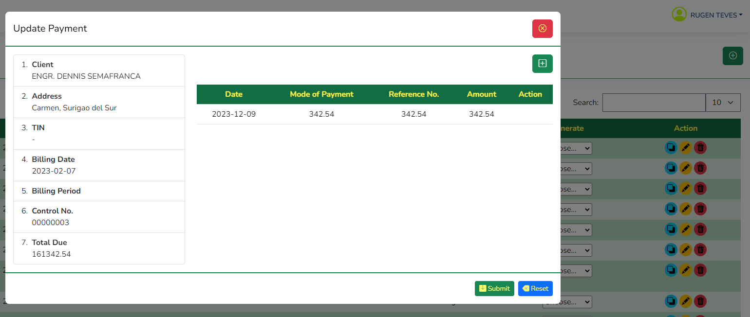
Changes for Receivable Payment Only Admin can edit/Delete the Payment. After Adding by a non Admin user, User will no longer edit t=or delete the Payment Item

